Slide 1
Kinematics (Rotation Matrix, Euler angle, Quaternion, Transformation)
Speaker: Teng-Hu Cheng

Slide 2
Outlines
Coordinate Systems
Rotation matrix
Euler angles
Transformation
Quaternion

Slide 3
Outlines
Coordinate Systems
Rotation matrix
Euler angles
Transformation
Quaternion

Slide 4
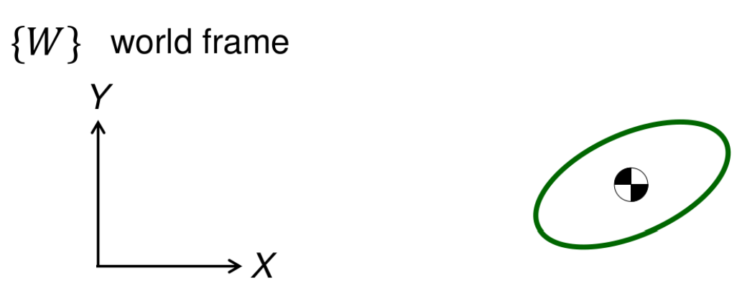
Coordinate Systems
Planar motion :
2 DOFs in translation
1 DOF in rotation
Rigid body motion:
3 DOFs in translation
3 DOFs in rotation

Slide 5
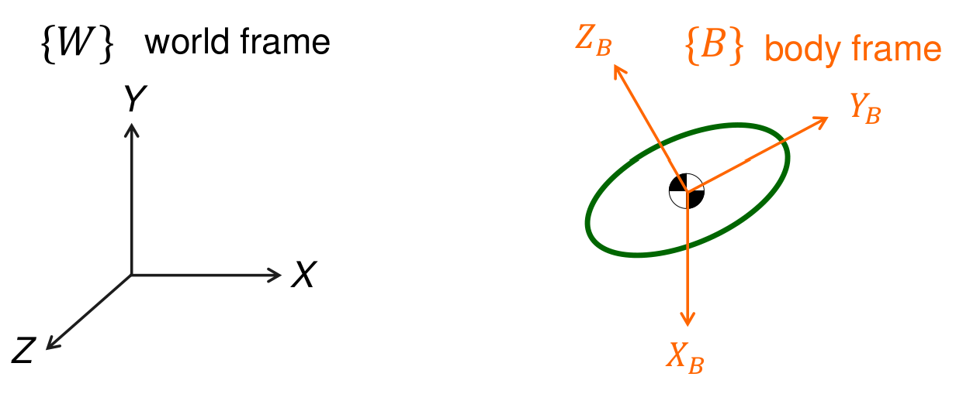
Coordinate Systems
Body frame is often defined on a rigid body
Translation: determined from the origin on body frame
Rotation: determined from the body frame

Slide 6
Coordinate Systems (Example 1/2)
2D coordinate
Q: 在 的哪裡?
y
思考流程:
黃色星星看原點在哪裡?
原點看藍色星星在哪裡?
--------------------- Ans.:
看原點是(-1, 1)
原點看 是(2.5, 2.5) 所以是(-1+2.5, 1+2.5)
= (1.5, 3.5)
(2.5,2.5)
x
(1,-1)

Slide 7
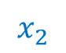
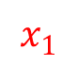
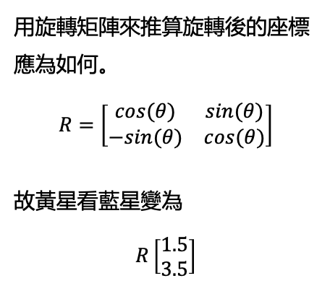
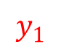
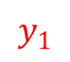


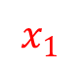
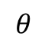
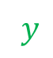
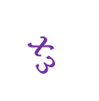
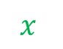

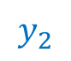

Coordinate Systems (Example 2/2)
2D coordinate
$y$
$$y_{2}$$
如果 座標旋轉的話，紅色位置向量在
該座標系表示為？
$$x_{2}$$
(2.5,2.5)
$$x$$
$$y_{1}$$
$$x_{1}$$
用旋轉矩陣來推算旋轉後的座標應為如何。
$$R=\left[\begin{matrix}cos(θ) & sin(θ) \\ −sin(θ) & cos(θ)\end{matrix}\right]$$
故黃星看藍星變為
$$R\left[\begin{matrix}1.5 \\ 3.5\end{matrix}\right]$$
(1,-1)
$$y_{3}$$
$$x_{3}$$
How about view by the $3^{rd}$ coordinate system?
將兩座標原點重疊
$y$
$$y_{1}$$
$$θ$$
$$x_{1}$$
$$x$$

Slide 8
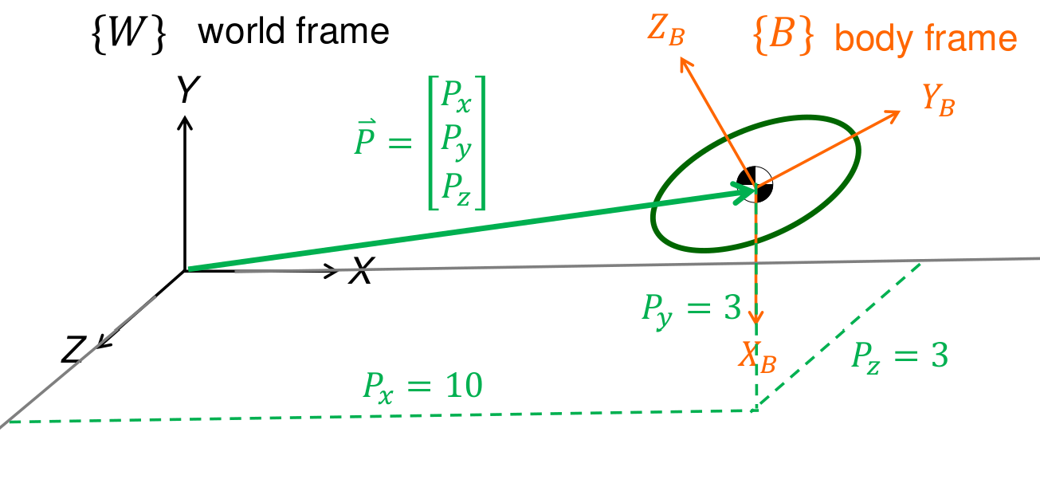
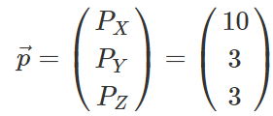
Coordinate Systems
3D coordinate
EX :
But which coordinate system?

Slide 9
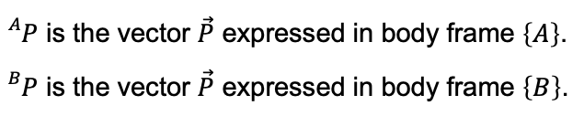
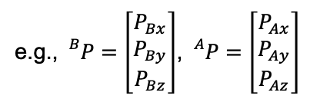
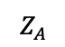
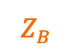
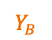
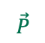
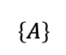

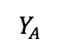
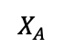
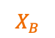
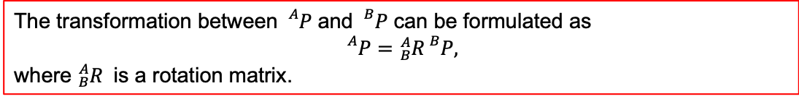
Coordinate Systems (3D)

Slide 10
Outlines
Coordinate Systems
Rotation matrix
Euler angles
Transformation
Quaternion

Slide 11
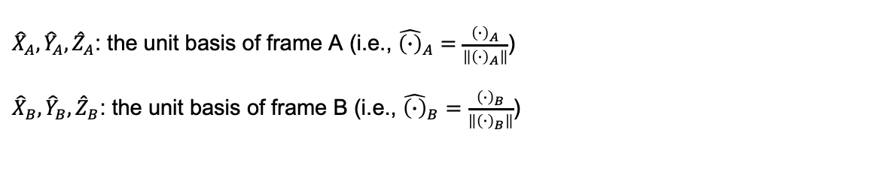
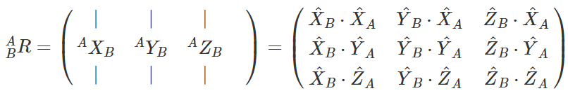
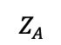
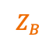
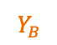
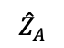
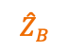
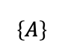
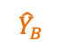
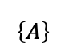
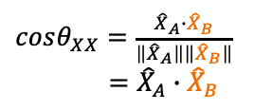

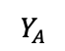

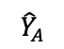
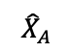
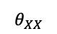
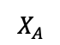
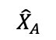
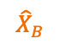
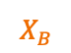
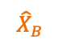
Rotation Matrix

Slide 12
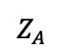
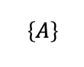
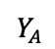
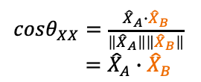


























Rotation Matrix

Slide 13























Rotation Matrix

Slide 14











Rotation Matrix
$$\left[\begin{matrix}P_{Ax} \\ P_{Ay} \\ P_{Az}\end{matrix}\right]={}_{B}^{A}R\left[\begin{matrix}P_{Bx} \\ P_{By} \\ P_{Bz}\end{matrix}\right]$$
$$\left[\begin{matrix}P_{Ax} \\ \\ \end{matrix}\right]=$$
$$\left[\begin{matrix}P_{Bx} \\ P_{By} \\ P_{Bz}\end{matrix}\right]$$
$$\left[\begin{matrix}P_{Ax} \\ P_{Ay} \\ P_{Az}\end{matrix}\right]=$$
$$\left[\begin{matrix}P_{Bx} \\ P_{By} \\ P_{Bz}\end{matrix}\right]$$
$$\left[\begin{matrix} \\ P_{Ay} \\ \end{matrix}\right]=$$
$$\left[\begin{matrix}P_{Bx} \\ P_{By} \\ P_{Bz}\end{matrix}\right]$$
$$\left[\begin{matrix}P_{Ax} \\ P_{Ay} \\ P_{Az}\end{matrix}\right]=$$
$$\left[\begin{matrix}P_{Bx} \\ P_{By} \\ P_{Bz}\end{matrix}\right]$$
$$\left[\begin{matrix} \\ \\ P_{Az}\end{matrix}\right]=$$
$$\left[\begin{matrix}P_{Bx} \\ P_{By} \\ P_{Bz}\end{matrix}\right]$$

Slide 15




Rotation Transformation
Original coordinate:
New coordinate:

Slide 16













Example : Rotation Matrix
X
$$y^{′}$$
$${30}^{o}$$
$$y$$
$$z$$
Top view
$$z^{′}$$
Z
Rotate -30˚ about the z axis of frame {B}
$$x^{′}$$
$$y^{′}$$
$$x$$
$$y$$
Y
$$x$$
$$x^{′}$$
$$\left[\begin{matrix}{\hat{X}}_{A}∙{\hat{X}}_{B} \\ {\hat{Y}}_{A}∙{\hat{X}}_{B} \\ {\hat{Z}}_{A}∙{\hat{X}}_{B}\end{matrix}\right]=\left[\begin{matrix}0.866 \\ 0.5 \\ 0\end{matrix}\right]$$
$$\left[\begin{matrix}{\hat{X}}_{A}∙{\hat{Y}}_{B} \\ {\hat{Y}}_{A}∙{\hat{Y}}_{B} \\ {\hat{Z}}_{A}∙{\hat{Y}}_{B}\end{matrix}\right]=\left[\begin{matrix}−0.5 \\ 0.866 \\ 0\end{matrix}\right]$$
$$\left[\begin{matrix}{\hat{X}}_{A}∙Z_{B} \\ {\hat{Y}}_{A}∙{\hat{Z}}_{B} \\ {\hat{Z}}_{A}∙{\hat{Z}}_{B}\end{matrix}\right]=\left[\begin{matrix}0 \\ 0 \\ 1\end{matrix}\right]$$
X
$${}_{B}^{A}R=\left[\begin{matrix}\begin{matrix}{\hat{X}}_{A}∙{\hat{X}}_{B} \\ {\hat{Y}}_{A}∙{\hat{X}}_{B} \\ {\hat{Z}}_{A}∙{\hat{X}}_{B}\end{matrix} & \begin{matrix}{\hat{X}}_{A}∙{\hat{Y}}_{B} \\ {\hat{Y}}_{A}∙{\hat{Y}}_{B} \\ {\hat{Z}}_{A}∙{\hat{Y}}_{B}\end{matrix} & \begin{matrix}{\hat{X}}_{A}∙Z_{B} \\ {\hat{Y}}_{A}∙{\hat{Z}}_{B} \\ {\hat{Z}}_{A}∙{\hat{Z}}_{B}\end{matrix}\end{matrix}\right]$$
$=\left[\begin{matrix}\begin{matrix}0.866 \\ 0.5 \\ 0\end{matrix} & \begin{matrix}−0.5 \\ 0.866 \\ 0\end{matrix} & \begin{matrix}0 \\ 0 \\ 1\end{matrix}\end{matrix}\right]$
Y
Blue line : World Frame {A}
Orange line : Body Frame {B}

Slide 17



Rotation Matrix

Slide 18

Properties of Rotation Matrices

Slide 19



Rotation Matrix
Multiply R by its transpose

Slide 20





Example : Rotation Transformation
X
$${30}^{o}$$
y
$$y^{′}$$
$$z$$
Y
$$z^{′}$$
Top view
x
$$x^{′}$$
Z
$$y^{′}$$
$$y$$
Rotate 30˚ about the Z axis
of frame {A}
$$x$$
$$x^{′}$$
$$\left[\begin{matrix}{\hat{X}}_{B}∙{\hat{X}}_{A} \\ {\hat{Y}}_{B}∙{\hat{X}}_{A} \\ {\hat{Z}}_{B}∙{\hat{X}}_{A}\end{matrix}\right]=\left[\begin{matrix}0.866 \\ −0.5 \\ 0\end{matrix}\right]$$
$$\left[\begin{matrix}{\hat{X}}_{B}∙{\hat{Y}}_{A} \\ {\hat{Y}}_{B}∙{\hat{Y}}_{A} \\ {\hat{Z}}_{B}∙{\hat{Y}}_{A}\end{matrix}\right]=\left[\begin{matrix}0.5 \\ 0.866 \\ 0\end{matrix}\right]$$
$$\left[\begin{matrix}{\hat{X}}_{B}∙Z_{A} \\ {\hat{Y}}_{B}∙{\hat{Z}}_{A} \\ {\hat{Z}}_{B}∙{\hat{Z}}_{A}\end{matrix}\right]=\left[\begin{matrix}0 \\ 0 \\ 1\end{matrix}\right]$$
$${}_{B}^{A}R=\left[\begin{matrix}\begin{matrix}{\hat{X}}_{B}∙{\hat{X}}_{A} \\ {\hat{Y}}_{B}∙{\hat{X}}_{A} \\ {\hat{Z}}_{B}∙{\hat{X}}_{A}\end{matrix} & \begin{matrix}{\hat{X}}_{B}∙{\hat{Y}}_{A} \\ {\hat{Y}}_{B}∙{\hat{Y}}_{A} \\ {\hat{Z}}_{B}∙{\hat{Y}}_{A}\end{matrix} & \begin{matrix}{\hat{X}}_{B}∙Z_{A} \\ {\hat{Y}}_{B}∙{\hat{Z}}_{A} \\ {\hat{Z}}_{B}∙{\hat{Z}}_{A}\end{matrix}\end{matrix}\right]$$
$=\left[\begin{matrix}\begin{matrix}0.866 \\ −0.5 \\ 0\end{matrix} & \begin{matrix}0.5 \\ 0.866 \\ 0\end{matrix} & \begin{matrix}0 \\ 0 \\ 1\end{matrix}\end{matrix}\right]$
= ${}_{A}^{B}{R^{T}}$
X
Y
Blue line : World Frame {A}
Orange line : Body Frame {B}

Slide 21











Example: Rotation Transformation
$$z$$
$$z^{′}$$
Z
$$y^{′}$$
X
$$y$$
Top view
$$x$$
$$x^{′}$$
p
$$y^{′}$$
$${}_{}^{B}P$$
X
y
$${}_{}^{A}P$$
Y
Blue line : World Frame {A}
Orange line : Body Frame {B}
x
$$x^{′}$$
Y

Slide 22










Coordinate Transformation of Rotating Coordinates
Euler angle is used to indicate the corresponding angular relationship between the two coordinate systems, the conversion can be described as a linear transformation
$$z^{′}$$
$$z$$
$$φ$$
$$y^{′}$$
$$φ$$
$$y$$
$$x^{′}$$
$$x$$

Slide 23
















Coordinate Transformation of Rotating Coordinates
$$x^{′}$$
$$x$$
$$θ$$
$$z^{′}$$
$$θ$$
$$z$$
$$y^{′}$$
$$y$$
$$y$$
$$y^{′}$$
$$ψ$$
$$x^{′}$$
$$ψ$$
$$x$$
$$z^{′}$$
$$z$$

Slide 24







Example : Rotation Matrix
$$z$$
$${}_{}^{A}{p^{′}}$$
$${}_{}^{A}p$$
$${30}^{o}$$
z
$$y$$
$$x$$
$$x^{′}$$
x
y

Slide 25








Revisit - Rotation Matrix
X
$$y^{′}$$
$${30}^{o}$$
$$y$$
$$z$$
Top view
$$z^{′}$$
Z
Rotate -30˚ about the z axis of frame {B}
$$x^{′}$$
$$y^{′}$$
$$x$$
$$y$$
Y
$$x$$
$$x^{′}$$
X
${}_{B}^{A}R$=$\left[\begin{matrix}\begin{matrix}cos⁡({−30}^{0}) \\ −sin⁡({−30}^{0}) \\ 0\end{matrix} & \begin{matrix}sin⁡(−{30}^{0}) \\ cos⁡(−{30}^{0}) \\ 0\end{matrix} & \begin{matrix}0 \\ 0 \\ 1\end{matrix}\end{matrix}\right]$
$=\left[\begin{matrix}\begin{matrix}0.866 \\ 0.5 \\ 0\end{matrix} & \begin{matrix}−0.5 \\ 0.866 \\ 0\end{matrix} & \begin{matrix}0 \\ 0 \\ 1\end{matrix}\end{matrix}\right]$
Y
Blue line : World Frame {A}
Orange line : Body Frame {B}

Slide 26
Body-Fixed Rotation and Space-Fixed Rotation

Slide 27




















Body-Fixed Rotation

Slide 28

















Space-Fixed Rotation

Slide 29
Outlines
Coordinate Systems
Rotation matrix
Euler angle
Transformation
Quaternion

Slide 30
Euler Angle

Slide 31



















Euler Angles – Body-Fixed Rotation
Question: Is the mapping between a matrix and a sequence of 3 rotation 1-by-1?
And: No!
There are six possibilities of choosing the rotation axes for proper Euler angles. In all of them, the first and third rotation axes are the same. The six possible sequences are:
X-Y-X
X-Z-X
Y-X-Y
Y-Z-Y
Z-X-Z
Z-Y-Z
$$α$$
$$Z_{B}$$
$$Z_{B}$$
$$γ$$
$$Z_{A}$$
$$Z_{C}$$
$$Z_{D}$$
$$Z_{C}$$
$$Y_{D}$$
$$Y_{B}$$
$$Y_{B}$$
$$Y_{C}$$
$$β$$
$$Y_{C}$$
$$Y_{A}$$
$$X_{A}$$
$$X_{B}$$
$$X_{D}$$
$$X_{B}$$
$$X_{C}$$
$$X_{C}$$

Slide 32























Euler Angles – Body-Fixed Rotation Z-Y-Z
$$α$$
$$Z_{B}$$
$$Z_{B}$$
$$γ$$
$$Z_{A}$$
$$Z_{C}$$
$$Z_{D}$$
$$Z_{C}$$
$$Y_{D}$$
$$Y_{B}$$
$$Y_{B}$$
$$β$$
$$Y_{C}$$
$$Y_{C}$$
$$Y_{A}$$
$$X_{A}$$
$$X_{B}$$
$$X_{D}$$
$$X_{B}$$
$$X_{C}$$
$$X_{C}$$
$$\left(\begin{matrix}X_{D} \\ Y_{D} \\ Z_{D}\end{matrix}\right)=\left[\begin{matrix}cosγ & sinγ & 0 \\ −sinγ & cosγ & 0 \\ 0 & 0 & 1\end{matrix}\right]\left[\begin{matrix}cosβ & 0 & −sinβ \\ 0 & 1 & 0 \\ sinβ & 0 & cosβ\end{matrix}\right]\left[\begin{matrix}cosα & sinα & 0 \\ −sinα & cosα & 0 \\ 0 & 0 & 1\end{matrix}\right]\left(\begin{matrix}X_{A} \\ Y_{A} \\ Z_{A}\end{matrix}\right)$$
$=R_{γ}R_{β}R_{α}\left(\begin{matrix}X_{A} \\ Y_{A} \\ Z_{A}\end{matrix}\right)$
$$\left(\begin{matrix}X_{D} \\ Y_{D} \\ Z_{D}\end{matrix}\right)=R\left(\begin{matrix}X_{A} \\ Y_{A} \\ Z_{A}\end{matrix}\right)$$

Slide 33

Gimbal Lock
Gimbal Lock : https://www.youtube.com/watch?v=zc8b2Jo7mno

Slide 34


Exercises– Body-Fixed Rotation
Consider the following two cases of rotation with “Euler-angle” starting from frame {A} to frame {B}:
rotate x-axis 60° and rotate y-axis 30 °
rotate y-axis 60° and rotate x-axis 30 °
1 rotate x-axis 60° and rotate y-axis 30 °
2. rotate y-axis 60° and rotate x-axis 30 °

Slide 35
Outlines
Coordinate Systems
Rotation matrix
Euler angles
Transformation
Quaternion

Slide 36
Transformation

Slide 37




Recap
P

Slide 38




Transformation Matrix

Slide 39


Transformation Matrix
${}_{}^{A}P={}_{B}^{A}R{}_{}^{B}P+{{}_{}^{A}P}_{Borg}={}_{B}^{A}R$ ${}_{}^{B}P$

Slide 40



Transformation Matrix – Pure Rotation

Slide 41




Transformation Matrix – Breakdown
Continuous operation conversion

Slide 42






Example 1 - Transformation
A:
$$y^{′}$$
{B}
(3, 7, 0)
$$y$$
$$x^{′}$$
(10, 5, 0)
y
$${θ= 30}^{o}$$
$$z^{′}$$
{A}
$$x$$
$$z$$
z
x

Slide 43





Continuous Transformation
$${}_{}^{C}P$$

Slide 44








Inverse Transformation
Therefore, inverse transformation is formulated as:

Slide 45



Example - Transformation
$$y^{′}$$
{B}
(3, 7, 0)
$$y$$
$$x^{′}$$
(10, 5, 0)
y
$${θ= 30}^{o}$$
$$z^{′}$$
{A}
$$x$$
$$z$$
z
x

Slide 46






Transformation Matrix Operator
Given the relation in the left figure, find the relative relationship of the unknowns.

Slide 47


Transformation Matrix - Properties

Slide 48

Exercises

Slide 49
Outlines
Coordinate Systems
Rotation matrix
Euler angles
Transformation
Quaternion

Slide 50
Quaternion

Slide 51

Quaternion
Preface:
Quaternion is fundamental math of formula, it describes UAV, Robotic arm, and Various robot states.
Describe Quaternion:
William Rowan Hamilton is a mathematician, he creates quaternion that involving three complex of dimensional and one real number of one dimensional. Quaternionic use is as a tool for physics expression space. Quaternion is an extension of the complex system, so understanding the complex is helpful for understanding the quaternion.
Ref.:
https://www.youtube.com/watch?v=zjMuIxRvygQ
https://en.wikipedia.org/wiki/Quaternion

Slide 52




Quaternion
Multiplication of basis elements:
The multiplication of quaternions can be organized into the following tables:
Note: you can find that the quaternion does not satisfy commutative law.

Slide 53

Arithmetic Quaternion
Suppose there are two quaternions
We define addition as below
scalar
vector
We define subtraction as below

Slide 54






Simplified Representation of Quaternion
Because $q=w\text{+}x\vec{i}\text{+}y\vec{j}\text{+}z\vec{k}$, we can divide it into two parts: the scalar $S=w$, and the vector $\vec{V}=x\vec{i}\text{+}y\vec{j}\text{+}z\vec{k}$. Therefore, it can also be expressed as $q=\left(S, \vec{V}\right).$
The quaternionic multiplication can be expressed as
Note: denotes dot product, and denotes vector product
Supplementary: https://www.youtube.com/watch?v=d4EgbgTm0Bg

Slide 55


Properties of Quaternion
Norm of quaternion:

Slide 56



The Relationship Between Quaternion and Rotation
The relationship between quaternion and a rotation w.r.t. a axis can be described as follows:
Suppose there is a vector $\vec{n}$ and an angular rotation $θ$ as below.
It can be converted to a quaternion:
Note: Use this method, it can convert any vector to quaternion

Slide 57






Theorem of Quaternion - Rotation of a Vector
where the scalar part is 0.

Slide 58



Theorem of Quaternion - Rotation of a Vector
where
It implies that
Note : The rotation matrix with angle θ is actually rotation 2θ angle in the quaternion

Slide 59




Example 4.q1
According the definition of quaternion
We can apply the relation from (4.q1)
Equivalently,
From (4.q1) and (4.q2),

Slide 60










Theorem of Quaternion- Rotation of a Coordinate System
Conversely, given a vector $p=x_{1}\vec{i}+x_{2}\vec{j}+x_{3}\vec{k}$ in the coordinate system $XYZ$, the $XYZ$ coordinate system is rotated by a quaternion $q$ to $X^{′}Y^{′}Z^{′}$, and vector $p$ expressed in the $X^{′}Y^{′}Z^{′}$coordinate system denoted as $p^{′}$ is expressed as

Slide 61












Example 4.q2
Answer: according the definition of quaternion
We can apply the relation from (4.q3)

Slide 62

Application 4.q3
Given the attitude of the sensor as ${}_{E}^{S}q$ (rotating from the earth frame to the sensor frame), the gravity in the earth frame as ${}_{}^{E}d={\left[\begin{matrix}0 & 0 & g\end{matrix}\right]}^{T} ,$ and the measurement of accelerometer in the sensor frame as ${}_{}^{s}s$, find the relation between ${}_{}^{E}d$ and ${}_{}^{s}s.$

Slide 63





Dynamics of Quaternion
Two rotation quaternions can be combined into one equivalent quaternion by the relation:
$q_{3}=q_{2}⊗q_{1}$,
where $q_{3}$corresponds to the rotation $q_{1}$ followed by the rotation $q_{2}$.
$$\dot{q}=\frac{1}{2}q⊗ω^{s}$$
$$\dot{q}=\frac{1}{2}ω^{n}⊗q$$
, $ω^{s}$ is the angular velocity vector measured in the body-fixed frame (e.g., sensor frame)
, $ω^{n}$ is the angular velocity vector measured in the inertial frame

Slide 64


Euler Angle Convert to Quaternion

Slide 65





Quaternion Convert to Euler Angle
Given a unit quaternion, and based on (4.q2 ) in the page
the rotation matrix of the quaternion can be expressed as
$$p^{′}=qpq^{−1}$$
$=Rp$ (4.q2)
Euler Angle Convert to Rotation Matrix
$$R=R_{Z}\left(ψ\right)R_{Y}\left(θ\right)R_{X}\left(φ\right)=$$
Note: $R_{Z}\left(ψ\right)R_{Y}\left(θ\right)R_{X}\left(φ\right)$ is a rotation matrix that may be used to represent a composition of extrinsic rotations about axes z, y, x, (in that order).
Ref: https://en.wikipedia.org/wiki/Euler_angles

Slide 66



Rotation Matrix Convert to Euler Angle
Or equivalently,

Slide 67


Two quaternions
A rotation about the z-axis through a bearing angle α followed by a rotation about the new y-axis through an elevation angle β. After these two rotations, the new x-axis points toward the satellite. The two rotations are respectively described by the two quaternions below:
The quaternion describing the composition rotation is the product pq which is as follows.

Slide 68
Compare Euler Angle, Rotation Matrix, and Quaternion
Rotation Matrix
Advantages
The rotating axis can be any vector
Disadvantages
A quaternion only needs four values: three vectors and an angle. But a rotation matrix needs 9 elements.
When doing multiplication operations, it also increases the amount of calculation, causing some waste in space and time.

Slide 69
Compare Euler Angle, Rotation Matrix, and Quaternion
Euler angle:
Advantages
Easy understanding
The expression is convenient. Only need three values (corresponding to the rotation angle of the x, y, and z axes)
Disadvantages
Euler angle converts to three 3*3 matrices with less efficiency compared to the quaternion.
The order of rotation matrix is fixed. Different orders will result in different results.
It can cause Gimbal Lock, so Euler angle cannot achieve at some angles.

Slide 70
Compare Euler Angle, Rotation Matrix, and Quaternion
Quaternion
Advantages
Avoid Gimbal Lock (refer to the link at the bottom)
Only need one four-dimensional
Disadvantages
Not easy to understand

Slide 71
Tasks
We give a simply example : point p= (1,0,1,w=0) rotate 90º around u = (0,1,0),Please find point?
Next, we use eigen of ROS system to find value, you can compare the two answers.

